Slide 1

A multivariate approach to combine general circulation models using graph cuts
Schmutz L., Thao S., Vrac M., Mariethoz G.

Slide 2
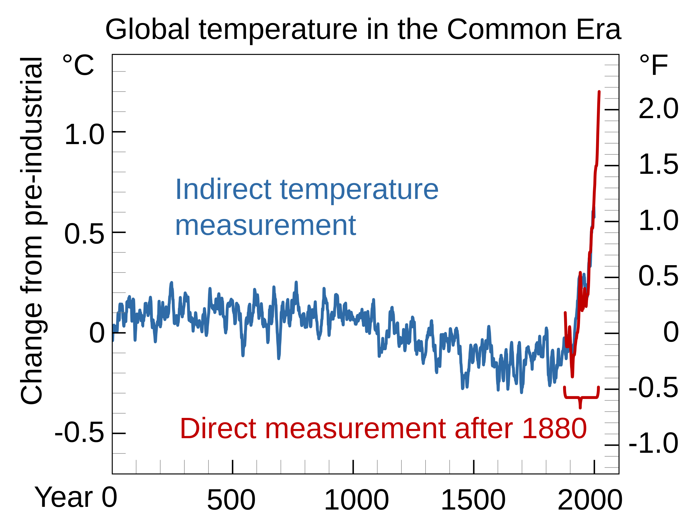
Climate change
Climate change
Climate change
The pace is increasing (change)
Increase in the frequency of extreme weather events (heat waves, floods, droughts, …)
Threat to human societies and ecosystems
→ We need models to predict the evolution and inform policy makers
Credit: Efbrazil
https://commons.wikimedia.org/wiki/File:Common_Era_Temperature.svg

Slide 3
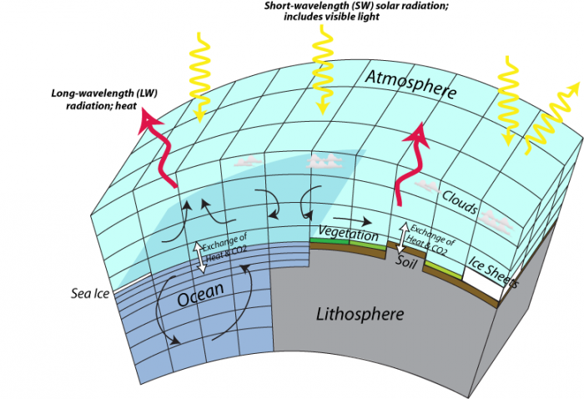
General Circulation Models
GCMs are complex mathematical models of the Earth
They simulate multiple Earth’s dynamic parameters (temperature, precipitation, wind, radiations, pressure, …)
They include models of the atmosphere, land, ocean, and ice
Discretized in cells and time-steps
30 models are used
Credit: David Bice © Penn State University is licensed under CC BY-NC-SA 4.0
https://www.e-education.psu.edu/earth103/node/524

Slide 4
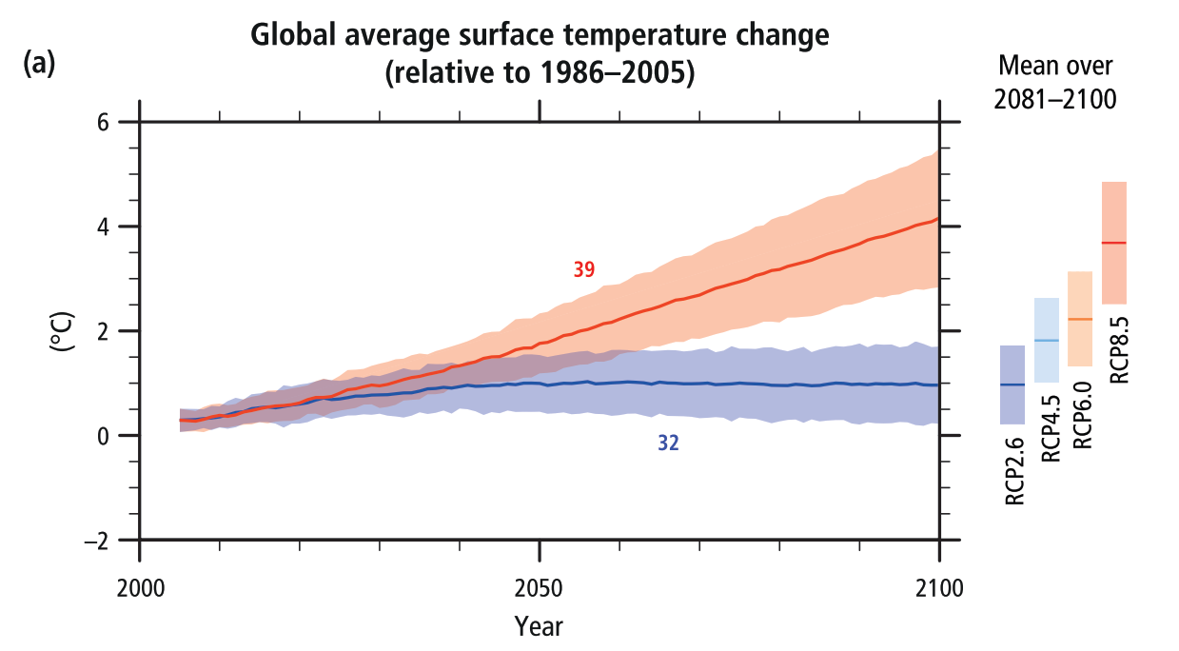
Multi-Model Ensembles and Multi-Model Mean
Models have biases
To extract a robust signal, they are assembled in Multi-Model Ensembles under different scenarios
Usually, models are assembled in unweighted mean
The assumption is that the ensemble is less biased than individual models and considered independent
Hypotheses: bias compensate each other
Obtained from: IPCC, 2014

Slide 5
How look this biases?
Image model biais locaux monde 2x
Différent l’un sur l’autre

Slide 6
Motivations
Some models are locally better than others
For each pixel, the model that minimizes a cost function is selected
Efficiently computes
This method is limited to one variable

Slide 7
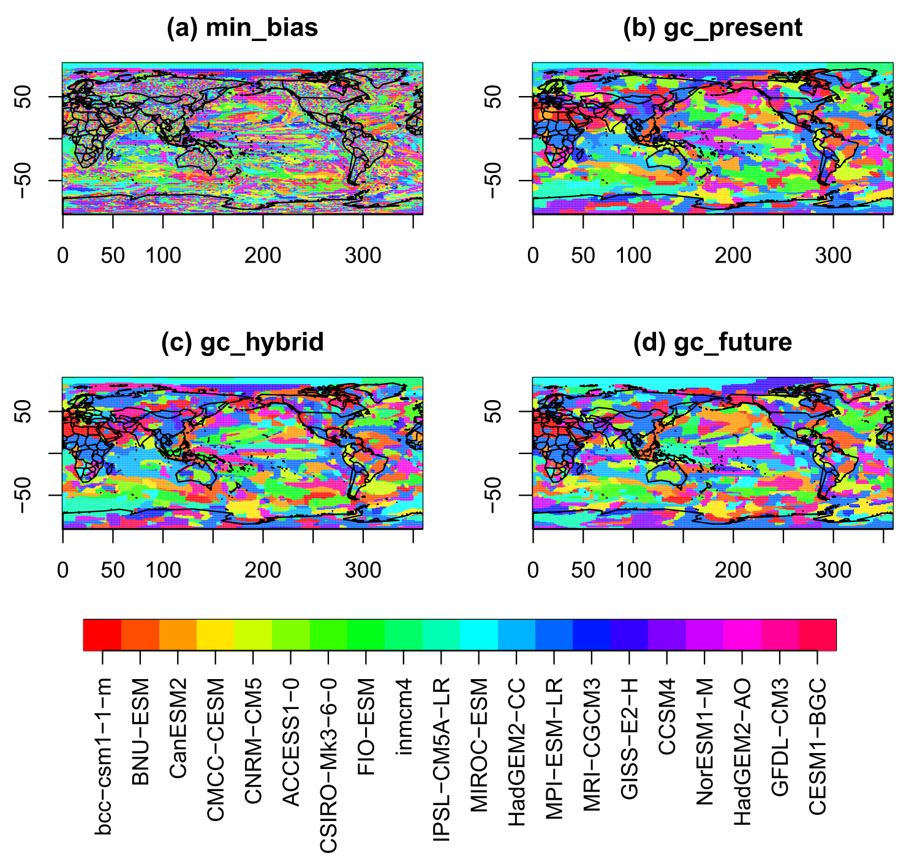
GCMs combination using graph cuts (Thao et al., 2022)
Some models are locally better than others
For each pixel, the model that minimizes a cost function is selected
Efficiently computes
This method is limited to one variable
Obtained from: Thao et al., 2022

Slide 8
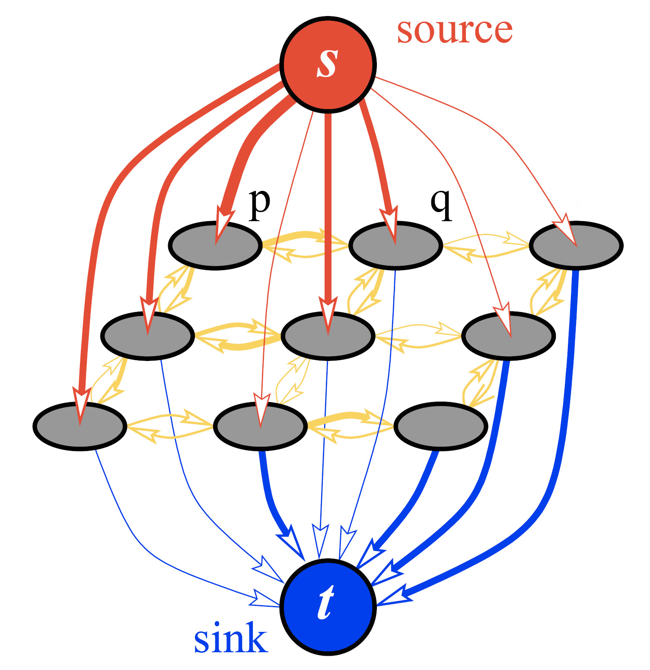
WTF is graph cut
Some models are locally better than others
For each pixel, the model that minimizes a cost function is selected
Efficiently computes
This method is limited to one variable
Image découpe optimal
Obtained from: Boykov & Funka-Lea, 2006

Slide 9
Resultat Soulivanh

Slide 10
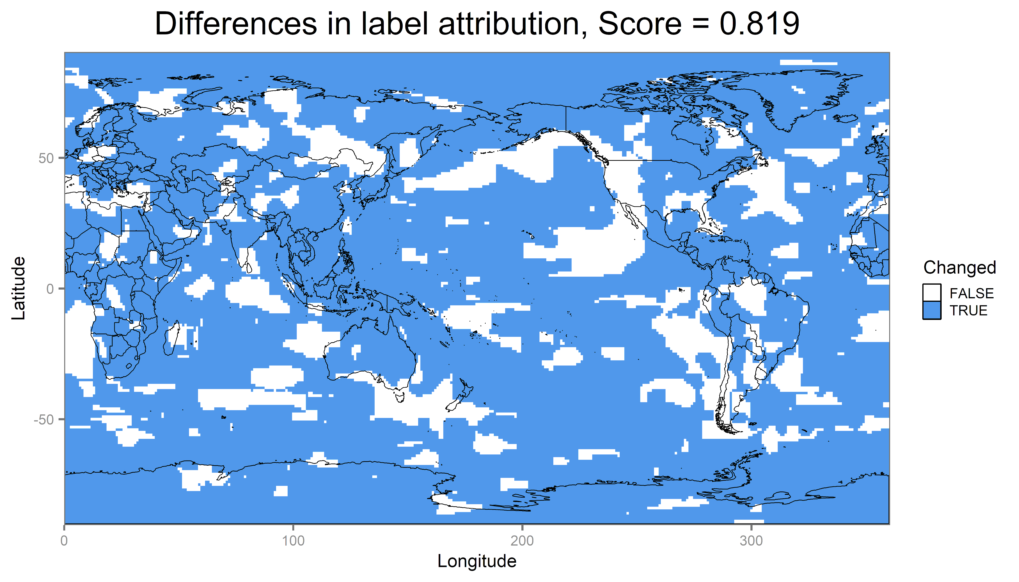
Temperatures and precipitation, ERA5 as reference

Slide 11
Our approach

Slide 12
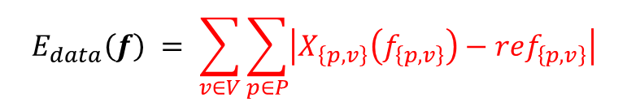
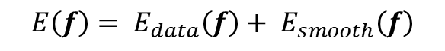

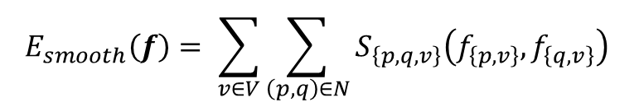
Multi-variate optimization using graph cuts
Energy function
$$\begin{aligned}&E\left(f\right)= E_{data}\left(f\right)+ E_{smooth}\left(f\right)\#\end{aligned}$$
Data energy
Diffenrence between a model and the reference for each variable and grid location
$$E_{data}\left(f\right) = \sum_{v∈V}{\sum_{p∈P}{\left|X_{\left\{p,v\right\}}\left(f_{\left\{p,v\right\}}\right)−{ref}_{\left\{p,v\right\}}\right|}}$$
Smooth energy
4 neighboor sum of the gradient error between models
$$E_{smooth}\left(f\right)= \sum_{v∈V}{\sum_{\left(p,q\right)∈N}{S_{\left\{p,q,v\right\}}\left(f_{\left\{p,v\right\}},f_{\left\{q,v\right\}}\right)}}$$
$$S_{\left\{p,q\right\}}\left(f_{p},f_{q}\right)=\left|X_{p}\left(f_{p}\right)−X_{p}\left(f_{q}\right)\right|+\left|X_{q}\left(f_{p}\right)−X_{q}\left(f_{q}\right)\right|$$

